Slide 1

DETECTION OF MENTAL ILLNESS USING MACHINE LEARNING
Under the esteemed guidance of
U.SaiAnusha,MCA
Asst.Professor
Team Members
SK.Heenakousar (19471A05B7)
M.Maneesha (19471A05A6)
M.Prasanna (19471A05A0)

Slide 2
CONTENTS
Abstract
Introduction
Software Requirements
Hardware Requirements
Existing System
Proposing System
Dataset
Preprocessing
Screenshots of Project
Future Scope
Conclusion

Slide 3
ABSTRACT
Mental health is very important at every stage of life, from childhood and adolescence through adulthood. It is becoming a serious global health problem, with a growing number of patients suffering from depression, anxiety and other disorders. New solutions are needed to tackle this issue. The main goal of this research project is to develop prediction models to classify users with poor mental health and then implement an intervention model to help these users. This study identified machine learning techniques and assessed their accuracy in identifying mental health issues using several accuracy criteria.

Slide 4
INTRODUCTION
A person’s mental well-being is his or her mental condition, as well as an overview of his or her general environment. Brain chemistry abnormalities are the cause of mental illness. An individual’s mental health serves as a barometer for properly addressing his or her diseases. To predict any health-related irregularities, it is critical to keep track of diverse groups’ mental health profiles.
Although screening test solutions exist, due to time and financial constraints, this solution is not feasible for large populations. Furthermore, diagnosis-based procedures have the unintended consequence of discouraging unwell people from taking part. As a result, psychological problems frequently go unnoticed or untreated.

Slide 5
LITERATURE SURVEY
The study assessed the performance of different machine learning algorithms which classify the dataset into various issues of mental health. It explains that mental health analysis in terms that are intuitive to different target groups. They have created a system for determining an individual’s mental health status and prediction models were built using this framework. We use different methods such as:
Logistic Regression
K-Nearest Neighbor Classifier
Decision Tree classifier
Random Forest Classifier
Stacking
AdaBoost Classifier
Gradient Boosting Classifier

Slide 6
Logistic Regression Classifier : Logistic regression is used to expect the output of specific structured variables. the result should be a categorical or discrete value. It can be 0 or 1, Yes or No, true or false, and so on, but it delivers probabilistic values that are somewhere between 0 and 1 instead of giving exact values like 0 and 1.
K-Nearest Neighbour Classifier : In the K-NN method, the existing cases and new case/data will be similar. KNN is a non-parametric algorithm that doesn’t make any assumption of its underlined data or its distribution. And also it works with multiple classes.
Decision Tree Classifier : A decision tree is a diagram that individuals use to illustrate a statistical likelihood or to determine the sequence of events, actions, or outcomes.
Random Forest Classifier : It is a technique that solves classification as well as regression problems. However, it is frequently used for classification. Because it combines many decision trees to create a ”forest” and feeds random features from the input dataset to them, it is called a random forest.
Stacking : Stacked Generalization, or simply ”Stacking,” is a machine learning ensemble algorithm. Like bagging and boosting, it entails aggregating predictions from many machine learning models on the same dataset.

Slide 7
Below is the accuracy of all the classifiers –
Methods | Accuracy (%)
Logistic Regression | 79.63
K-Nearest Neighbour | 80.42
Decision Tree | 80.69
Random Forest | 81.22
Stacking | 81.75

Slide 8
AdaBoost Classifier : Boosting has been a prevalent technique for tackling binary classification problems. These algorithms improve the prediction power by converting a number of weak learners to strong learners . The principle behind boosting algorithms is first we built a model on the training dataset, then a second model is built to rectify the errors present in the first model. This procedure is continued until and unless the errors are minimized, and the dataset is predicted correctly.
Gradient Boosting Classifier : Gradient boosting is a machine learning technique used in regression and classification tasks, among others. It gives a prediction model in the form of an ensemble of weak prediction models, which are typically decision trees.

Slide 9
SOFTWARE & HARDWARE REQUIREMENTS
Software requirements
Operating system : windows 10
Browser : Any Latest Browser Like Chrome
Python Distribution : Anaconda (Pycharm), Flask, Jupyter Notebook
Hardware Requirements
Processor : Intel Core i5
Hard disk : 30GB or more
RAM : 1GB or more

Slide 10
EXISTING SYSTEM
Existing system focuses the accuracy of the Logistic Regression , K-Nearest Neighbour , Decision Tree, Random forest and stacking algorithms. Accuracy is one of the key property to evaluate metric that measures the number of correct predictions made by a model in relation to the total number of predictions made and visualization. The machine learning is being applied to label patients suffering from depression, anxiety and other disorders. Based on the result, the accuracy is achieved by the Logistic regression with an accuracy of 79.63% followed by the K-Nearest Neighbour with an accuracy of 80.42%.Decision Tree with an accuracy of 80.69% and Random Forest with an accuracy of 81.22% and Stacking with an accuracy of 81.75%.

Slide 11
Proposed System
The proposed system focuses the best accuracy of the above algorithms. Accuracy is one of the key property to evaluate metric that measures the number of correct predictions made by a model in relation to the total number of predictions made and visualization. The machine learning is being applied to label patients suffering from depression, anxiety and other disorders. Based on the result, the highest accuracy is achieved by the Adaboost classifier model with an accuracy of 72% followed by the Gradient boost classifier with an accuracy of 74%. And then we used Support Vector machine with accuracy 84% and Xgboost with accuracy of 86%..

Slide 12
Dataset Collection
The dataset is taken from the mentioned website:
https://www.kaggle.com/datasets/osmi/mental-health-in-tech-survey.
In the dataset contains 1259 rows and 27 columns of mental health illness prediction system which contains attributes Time Stamps ,Age , Gender , State , Self _ employee and so on…In the dataset contain one target variable column that is treatment . It performs an Ordinal encoder to predict the null values.

Slide 13
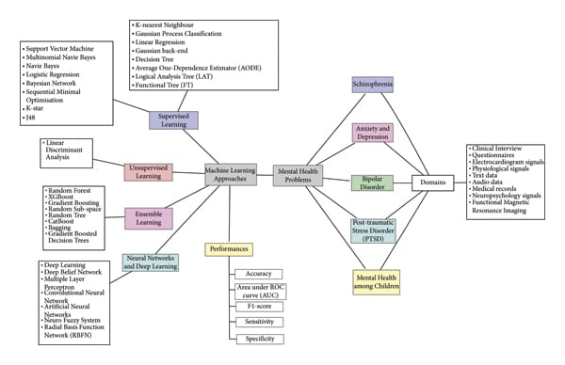
PREPROCESSING
Before feeding data to an algorithm we have to apply transformations to our data which is referred as pre-processing. By performing pre-processing the raw data which is not feasible for analysis is converted into clean data. In-order to achieve better results using a model in Machine Learning, data format has to be in a proper manner. The data should be in a particular format for different algorithms. For example, if we consider Random Forest algorithm it does not support null values. So that those null values have to be managed using raw data.

Slide 14
TESTING
# importing
import pandas as pd
import numpy as np
import matplotlib.pyplot as plt
import seaborn as sb import sklearn
#assigning dataset to data
data = pd.read_csv(r"C:\Users\Heena\mp\data\survey.csv")
#to know the shape and information of the dataset
data.shape
data.info()
#to check null values in dataset
data.isnull().sum()
data['state'].value_counts()
data['state'].fillna('CA',inplace=True)
data['self_employed'].value_counts()
data['self_employed'].fillna('No',inplace=True)
data['work_interfere'].value_counts()
data['work_interfere'].fillna('Sometimes',inplace=True)

Slide 15
#to modify the gender column
data['Gender'].replace(['Male','Male ','male','M','m','Cis Male','Man','cis male','Mail','Male-ish','Male (CIS)','Cis Man','msle','Malr','Mal', 'maile','Male','Make','male leaning androgynous','ostensibly male, unsure what that really means',],'Male',inplace=True)
data['Gender'].replace(['Female','Female ','female','F','f','woman','femail','Cis Female','cis-female/femme','Femake','Female (cis),'Woman',],'Female',inplace=True)
data['Gender'].replace(['Female (trans)','queer/she/they','non-binary','fluid','queer','Androgyne','Trans-female','male learning androgynous’, 'Agender','A little about you','Nah','All','ostensibly male','unsure what that really means','Genderqueer','Enby','p', 'Neuter','something kinda male?','Guy (-ish) ^_^','Trans woman'],'Trans',inplace=True)
#printing unique values in gender column
data['Gender'].unique()
#importing encoders
from sklearn. compose import ColumnTransformer
from sklearn. preprocessing import LabelEncoder, OrdinalEncoder
encoder = OrdinalEncoder()
X = ['Timestamp','Age','Gender','Country','state','self_employed','family_history','work_interfere','no_employees','remote_work','tech_company’, 'benefits','care_options','wellness_program','seek_help','anonymity','leave','mental_health_consequence','phys_health_consequence', 'coworkers','supervisor','mental_health_interview','phys_health_interview','mental_vs_physical', 'obs_consequence','comments']
X = encoder.fit_transform(data[X])

Slide 16
#performing label encoder
le = LabelEncoder()
y = le.fit_transform(y)
#splitting data
from sklearn.model_selection import cross_val_score
from sklearn.model_selection import train_test_split
X_train, X_test, y_train, y_test = train_test_split(X,y, test_size=0.3, random_state=49)
#shapes of the splitting data
X_train.shape, X_test.shape, y_train.shape, y_test.shape
#algorithms
from sklearn.linear_model import LogisticRegression
from sklearn.tree import DecisionTreeClassifier
from sklearn.neighbors import KNeighborsClassifier
from sklearn.ensemble import RandomForestClassifier, AdaBoostClassifier, GradientBoostingClassifier
from sklearn.metrics import accuracy_score
from sklearn.ensemble import StackingClassifier

Slide 17
#method
def model_test (X_train, X_test, y_train, y_test, model, model_name):
model.fit(X_train,y_train)
y_pred = model.predict(X_test)
accuracy = accuracy_score(y_test,y_pred)
print('====={}====='.format(model_name))
print('score is : {}'.format(accuracy))
print()
for model_name,model in model_dict.items():
model_test(X_train, X_test, y_train, y_test, model, model_name)

Slide 18
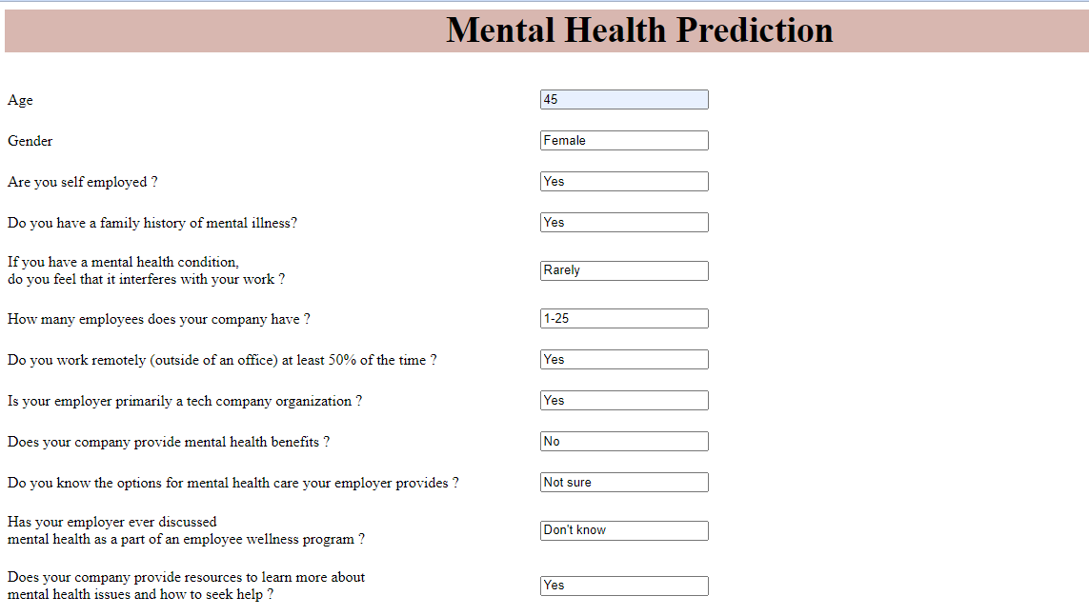
SCREENSHOTS OF THE PROJECT

Slide 19
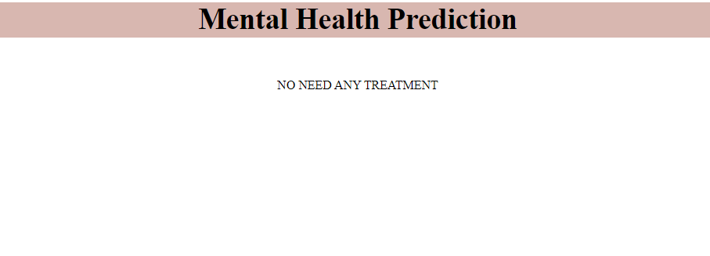

Slide 20
Conclusion
In this proposed work we have used different techniques of machine learning which are used to classify the dataset on various problems of mental health. It is very clear from the results that all the seven machine learning techniques give more accurate results. The accuracy of all the classifiers are above 79%. Nowadays, we have many special programs in the medical field that predict disease very accurately in advance so that treatment can be done effectively and efficiently. A large data set can be used and the research can be applied on the same for more accuracy.

Slide 21


